Slide 1
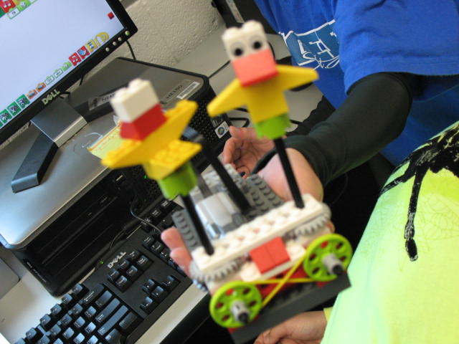
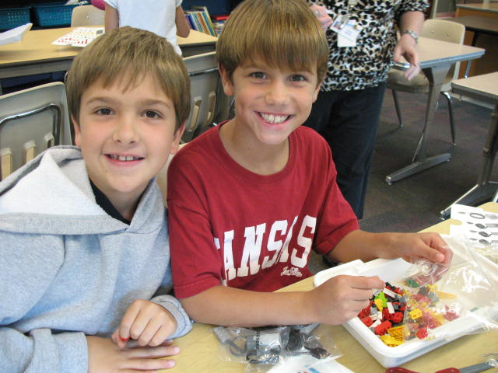
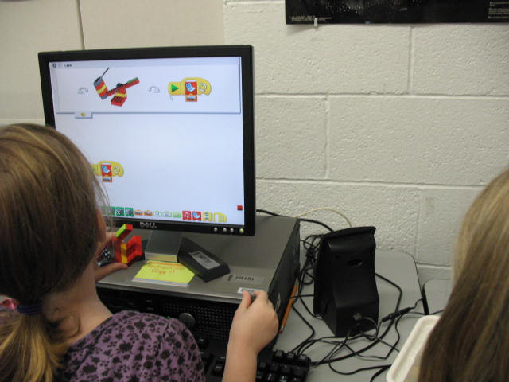
Who Does Robotics? WeDo!
LEGO Robotics for
Primary Students
Cindy Sheets
Podstock, 2011

Slide 2
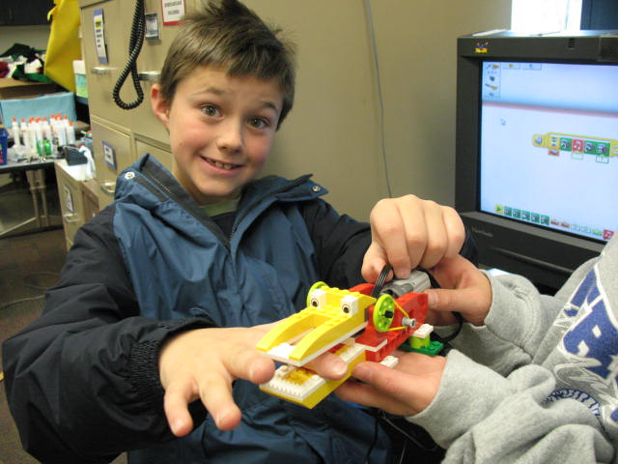
Who is it For?
2-4th Graders
New to Robotics

Slide 4
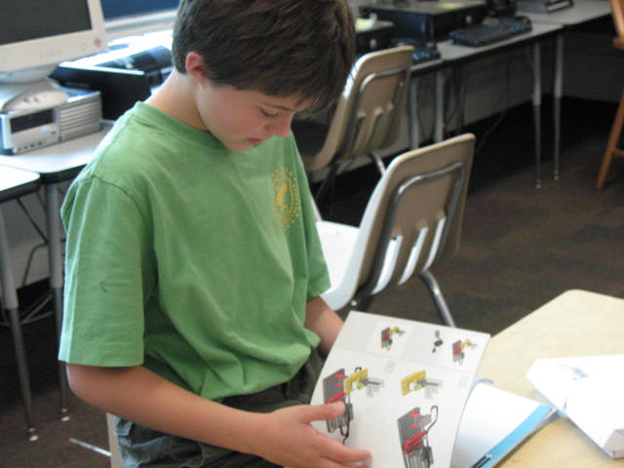
Learning Goals
Creative thinking
Vocabulary and communication skills
Cause – effect
Observation and measurement
Follow 2D drawings to create 3D model
Logical thinking

Slide 5
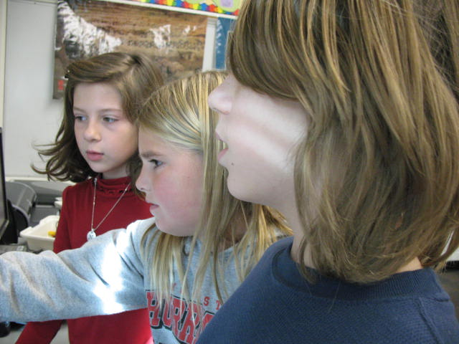
Curriculum
Science
Technology
Engineering
Mathematics
Language

Slide 6
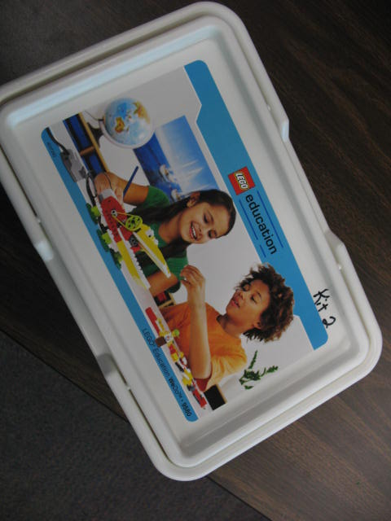
Getting Started
Guide to fundamentals
Building
Programming
Function

Slide 7
Organization

Slide 9
Success!

Slide 10
http://www.readwriteweb.com/archives/robots_for_everyone_getting_kids_interested_in_pro.php

Slide 11
WeDo with Scratch!
http://www.youtube.com/watch?v=EuMxc6zieSw tutorial
Using WEDO with Scratch programming
Scratch http://scratch.mit.edu

Slide 12
Where to Purchase
LEGO Education | Product#153AC2
LEGO Education | Product#15397A
LEGO Education | Product#153944

