Slide 1
Using Technology to Enrich Content, Process and Product
Cindy Sheets
Indiana Association for the Gifted December 2009
Shawnee Mission School District
913-993-3346
cindysheets@smsd.org

Slide 2
Where to Locate PowerPoint
Http://sheetsgiftedpages.com
Look for IAG powerpoints
http://sites.google.com/site/technologyand21stcenturyskills/

Slide 3
Join the Group! Getting to Know Nings
giftededucation.ning.com
International online community supporting gifted education
giftedtech.ning.com
Computers & Technology network/presentations from NAGC
ALMnetwork.ning.com
Online community supporting users of the Autonomous Learner Model
iConnectiLearn.ning.com
For those who are interested in 21st Century learning, web 2.0, and technology in the clasroom

Slide 4
Think & Share
In what ways do you utilize technology to enhance . . .
Content
Process
& Product

Slide 5
Why Technology?
Knowledge economy
nearly 90% of the
upcoming workforce
will utilize computers
within their working
environments

Slide 6
Technology
Cost/benefit
Low level vs high level use
integratation
quality teaching and
learning experiences

Slide 7
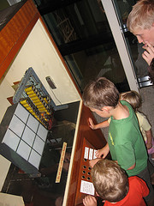
What Technology is NOT . . .
fancy workbooks
a place to put students to keep them occupied while we work with other students.

Slide 8
http://www.personalizemedia.com/garys-social-media-count/

Slide 9
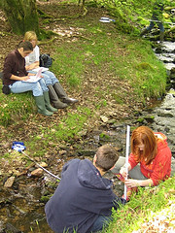
With Great Technology
Students Can:
support exploration
form and test hypotheses
discover new knowledge
Apply higher-order thinking skills
Explore real, open-ended questions,
http://www.ncrel.org/tech/elearn/system.htm E-Learning Synthesis: Curriculum and Standards-Based Content Learning Technologies and Higher-Order Skills

Slide 10
International Society for Technology in Education
National Education Technology Standards
Students
Teachers
Administrators
More than 90% of states have adopted, adapted or referenced in their own state standards

Slide 11
Partnership for 21st Century Skills
21st Century Skills
Helping Students Thrive in the
Digital Age
Digital Age Literacy
Inventive Thinking
Effective Communication
High Productivity

Slide 12
What Kinds of Technology Support Content?
Tutorials
Online Classes
Distance Learning
Online information resources
DVD
Software
Cable TV, Satellite
Streaming Video
Power Media Plus, Learn360
You Tube
Teacher Tube

Slide 13
iTunes U
Notes:
What are the advantages of this kind of program? Disadvantages?

Slide 14
Distance and Virtual Learning
MU Distance and Online Classes
Johns Hopkins Center for Talented Youth CTY
Davidson Institute’s Young Scholars Program

Slide 15
Quality Content Examples
Jason Project
UCMP (University of California Museum of Paleontology)
AMNH (American Museum of Natural History)
Nova
Center for Innovation in Engineering and Science
Annenberg Media

Slide 16
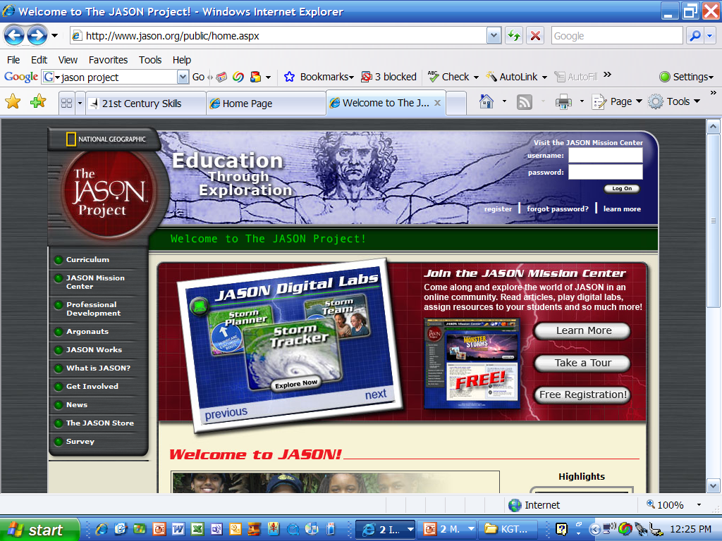
Notes:
Jason Project home page

Slide 17
Notes:
Jason Project Mars and Earth. Team Jason Online
Student & Teacher resources
Digital Labs
Student Journal
Chats, Bulletin Boards and Events

Slide 18
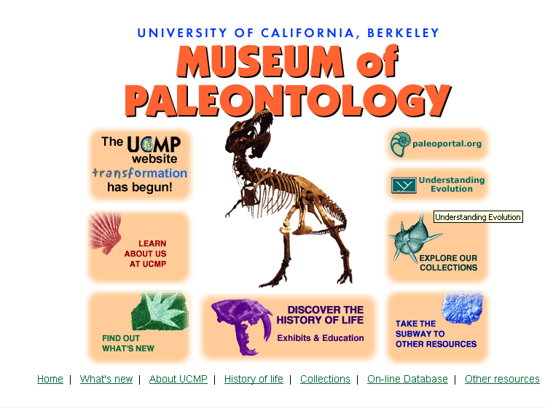
Notes:
UCMP Museum of Paleontology

Slide 19
Notes:
UCMP Explorations Through Time

Slide 20
Students keep a journal of their exploration with two paleontologists.
Notes:
UCMP Welcome to Dry Creek

Slide 21
Notes:
ologies

Slide 22
Notes:
Educational materials example

Slide 24
Notes:
AMNH archives and search info

Slide 25
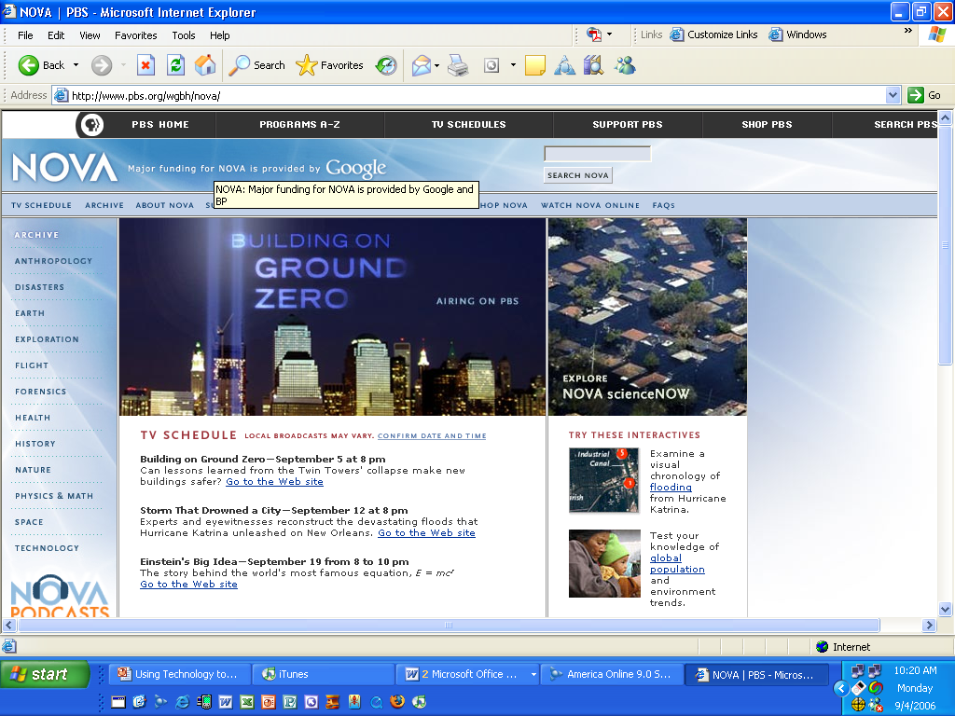

Slide 27
Center for Innovation in Engineering and Science

Slide 28
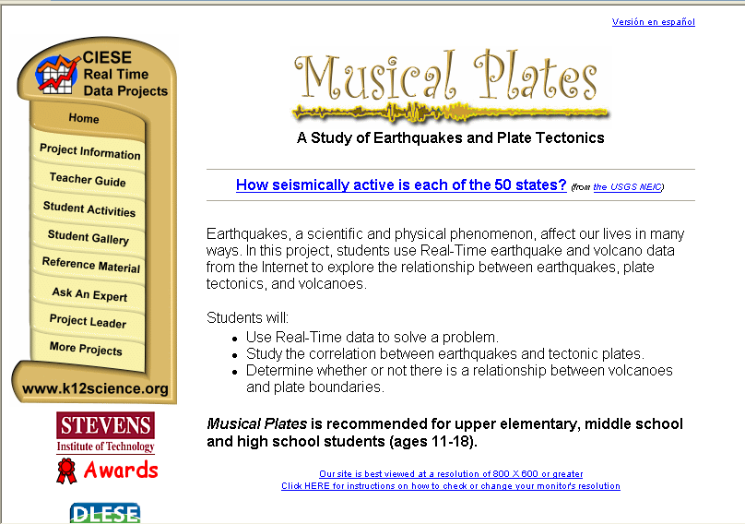

Slide 29
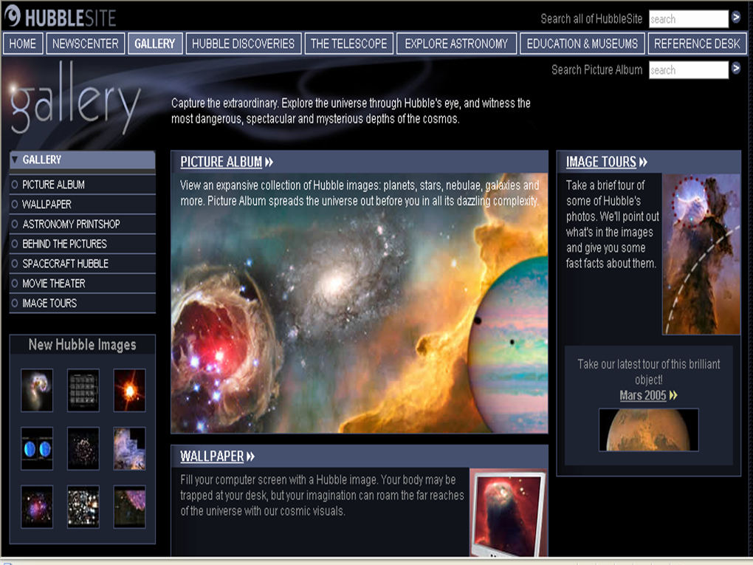

Slide 30
Annenberg Media

Slide 33
Primary Resources
Library of Congress
American Memory Collection
The Learning Page
National Archives
Regional Centers; Presidential Libraries
Eyewitness
Genealogy Resources; census records
Smithsonian Institute
Smithsonian for Kids; for Teachers
United States Holocaust Memorial Museum
National Gallery of Art
Interactive exhibit

Slide 34
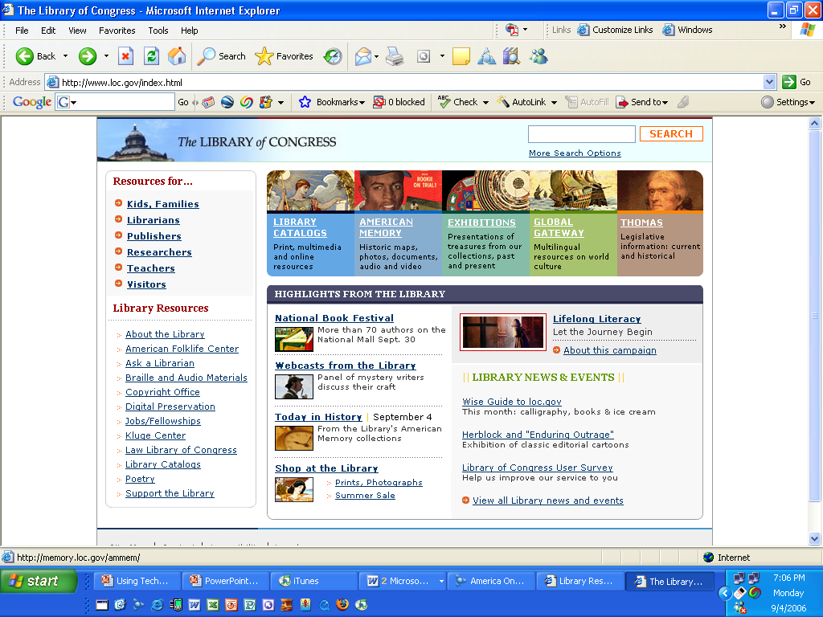

Slide 35
Notes:
http://memory.loc.gov/learn

Slide 37
Smithsonian Education
In 1881, an unmarried woman of 43, with no official training, decided to live with the Sioux women for 6 weeks to understand their way of life. This is her story, and her diary.
Photo Gallery, Diary Entries, Folk Tales

Slide 38
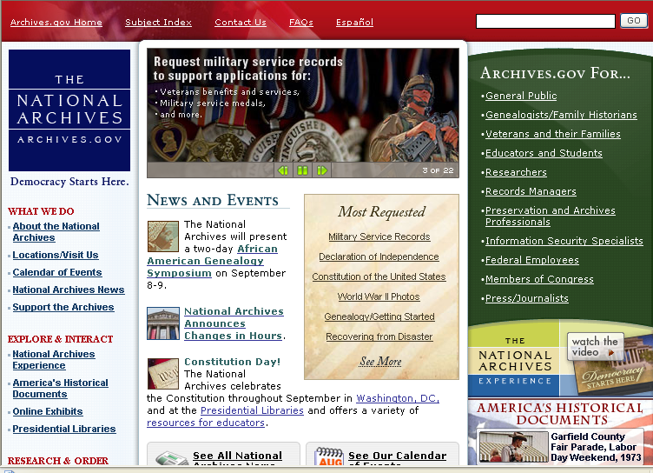

Slide 39
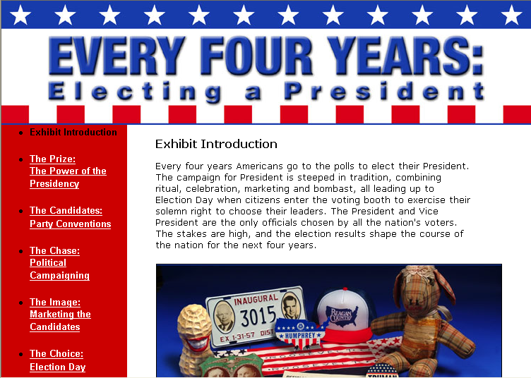
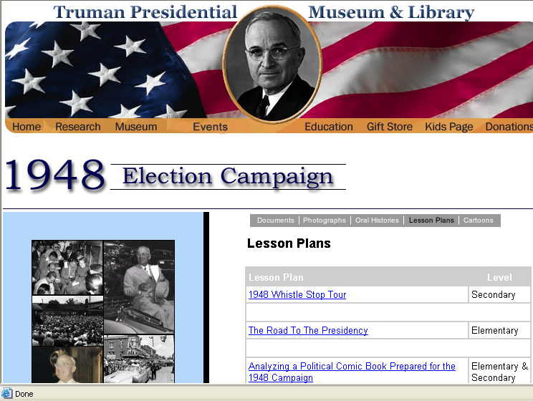
Notes:
Whistlestop Campaign
Political Comic Book
Political Cartoons and Analyzing Political Cartoons

Slide 40
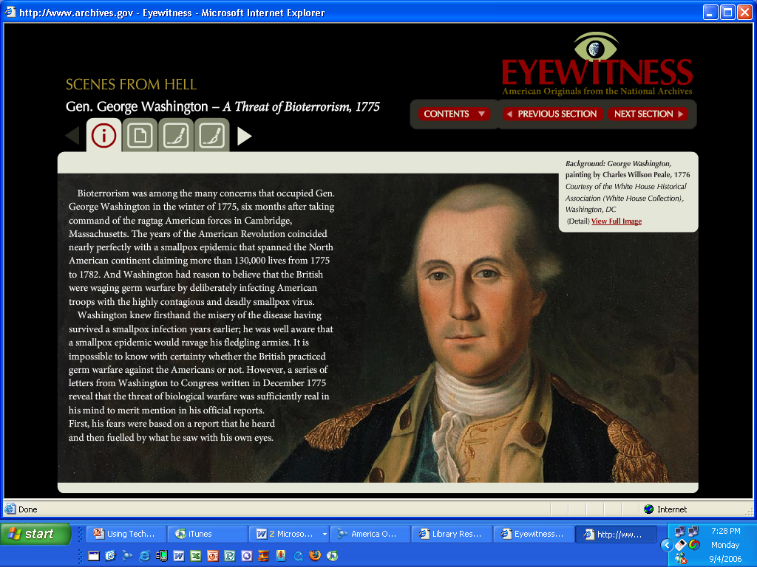
Notes:
Bioterrorism – smallpox?

Slide 41
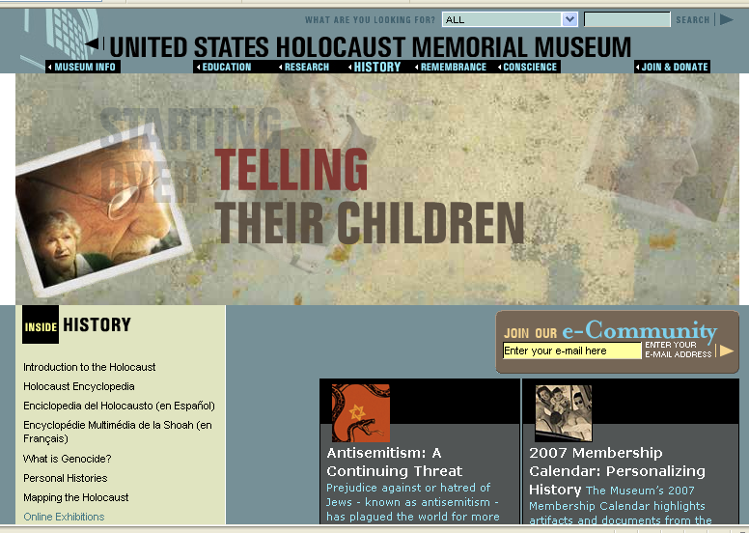

Slide 42
Online Exhibits

Slide 44
Students research using actual documents and databases to find out what happened to four different people.
Passenger Ship Lists
Auschwitz prisoners
Deportation Databases

Slide 45
Process
How the learning is accomplished
A course of action intended to achieve a result
What happens between the beginning and the end

Slide 46
Changing the Process . . .
Math concepts
Virtual manipulatives
Science – up to date information
Alternatives Net Frog
Research in “real time”
Newscasts (CNN for students)
Data (USGS)
Google Maps
Analyzing for validity
Global Connections

Slide 47
Technology & Process
VOD (video on demand)
United Streaming Video – Power Media Plus Learn360
Webquests
A WebQuest is an inquiry-oriented activity in which most or all of the information used by learners is drawn from the Web.
Adventure Into the Unknown A Webquest on the Lewis and Clark Expedition.htm
Moodle

Slide 48
Online Simulations
The final
mission is to
create a
habitable
planet
suitable for
humans.
NASA
Welcome to AstroAdventure

Slide 49
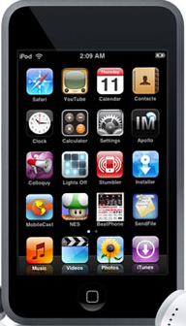
Handhelds, iPods, iTouch
Store and graph data
Journal recording
Record lectures and notes
Access video and podcasts
Foreign language dictionaries
Personal organization
Communication/sharing
Music lessons

Slide 50
Learn & Create with Podcasts
Collect
Create
Science Now (NOVA) podcasts
http://www.pbs.org/wgbh/nova/sciencenow/rss/#h01
iTunes
Podbean.com
Learning in Hand
learninginhand.com
Gcast
http://gcast.com
Garageband (Apple)
Audacity
Sourceforge.audacity.net

Slide 51
Interactive Web: Use and Create
Web 2.0
“Build applications that harness network effects to get better the more people use them.“
Wiki’s, social networking, blogs, podcasting,, Flickr, iTunes

Slide 52
Literature and Reference
Resources in reference, fiction & non-fiction
Bartleby.com
Shakespeare, major dictionaries and reference books, poets, dictionary of quotations, anthologies
Cyberguides
The International Children’s Digital Library . . . .
Different languages, classics and more

Slide 53
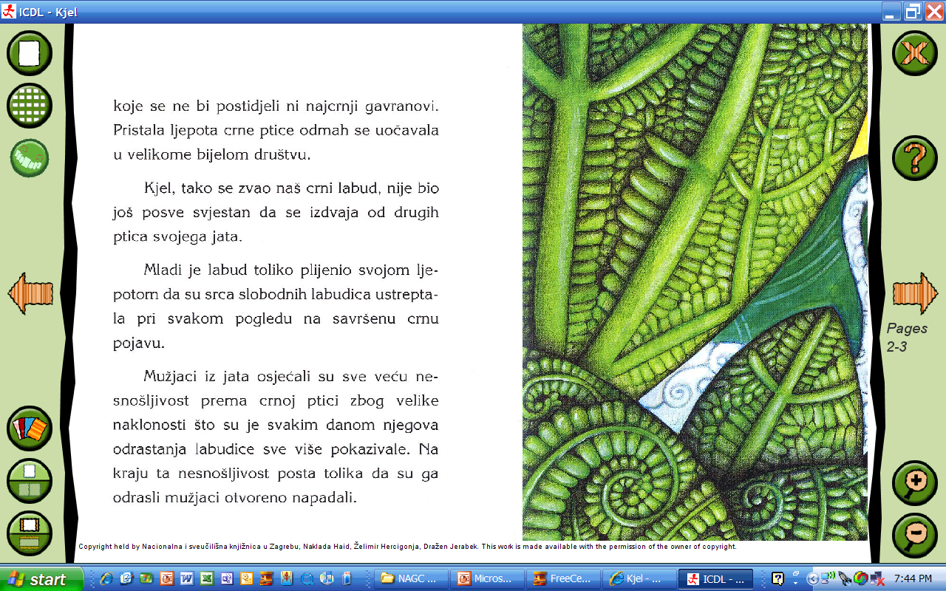
Book in Croation
Notes:
Folt

Slide 54
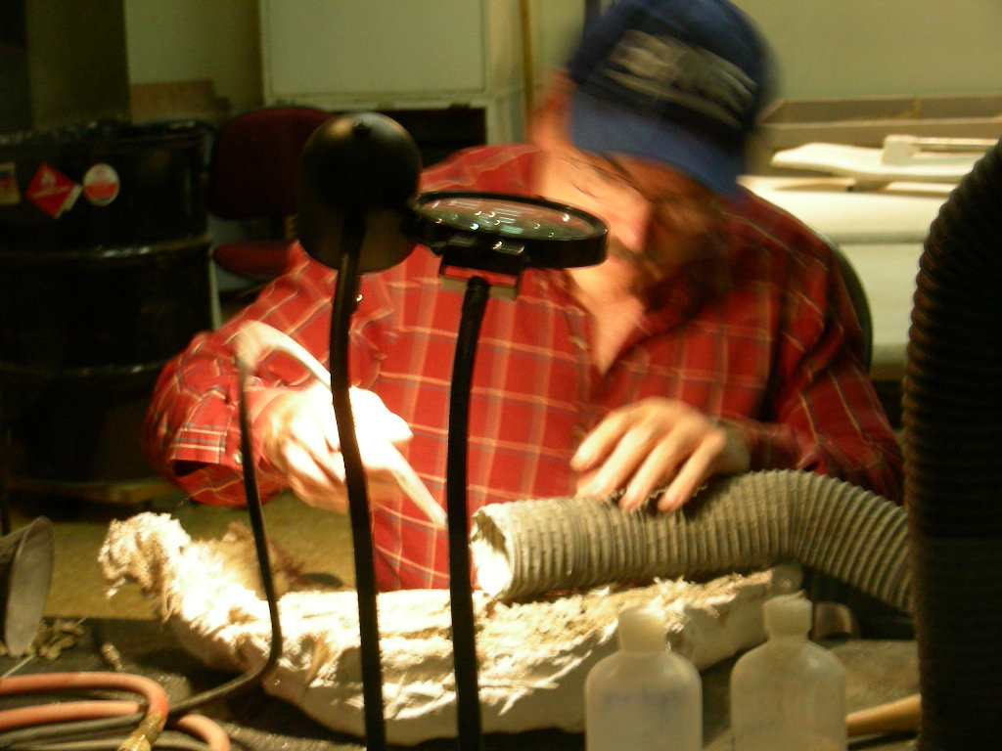
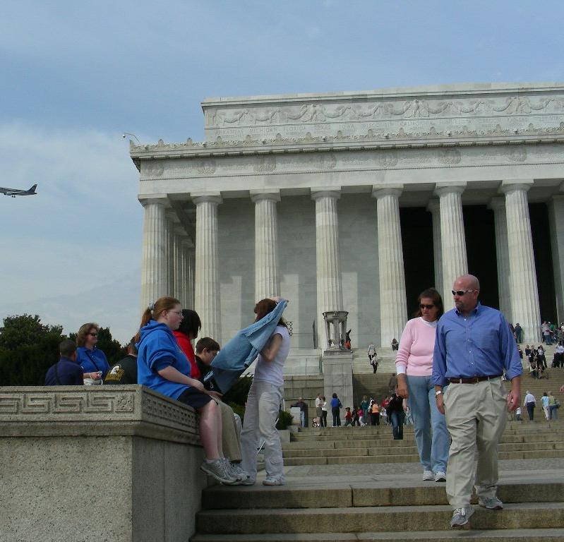
Content and Sharing
A Different Place
Chasing Vermeer
Visual/Virtual Field Trips
www.artsnacks.org
Digital Storytelling

Slide 55
Writing – Desktop Publishing
Templates
Reports, newsletters, booklets, brochures, outlines, presentations
Word processing and spell-checking
Laptops, AlphaSmart, NeoSmart NETBOOKS
Voice Recognition software
Publishing formats
Story starters/scholastic.com http://teacher.scholastic.com/activities/storystarters/storystarter1.htm
Read Write Think teacher and student materials and lessons
Lulu.com

Slide 56
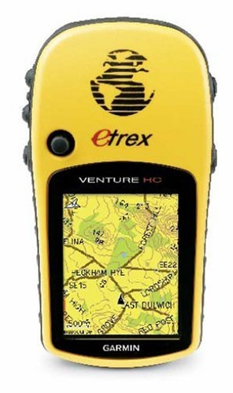
GPS / GIS/Google Earth
Geocaching
Where YOU are the search engine!
Groundspeak –
Benchmark Hunting Home Page.htm
Google Earth
Google Lit Trips
Scavenger hunts
Ancient Civilizations

Slide 57
Graphic Organizers
Inspiration Software, Inc.htm
Kidspiration, Inspiration Data
Versons for Handhelds (Palm and
Windows)
Sample 1 sample 2 sample 3
Schools of California Online Resources
http://www.sdcoe.k12.ca.us/score/actbank/torganiz.htm
Write Design Online
http://www.writedesignonline.com/organizers/

Slide 58
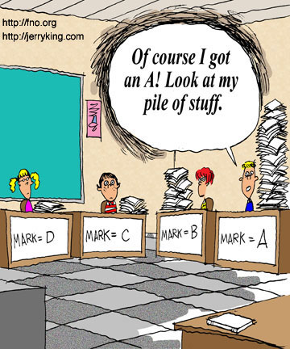
Research or Copying?

Slide 59
Where’s the Content?

Slide 60
Research
From Trivial Pursuit to Essential Questions.htm
The New York Times Learning Network
Guide to U_S_ Government for Kids
The Great Question Press
Thirteen Ed Online

Slide 61
Internet Research
Ivy’s Search Engine Resources for Kids
Kids Click
Wolfram Alpha all things mathematical
WebCrawler
Wikipedia

Slide 62
Google
Google searches
Maps, video, images, books (text), Google Earth and more
Google Scholar
Google squared
Wonder wheel
Forms (surveys)

Slide 63
Products
An artifact that has been created by someone or some process
The tangible and stable result of a performance or task

Slide 64
Technology Products
Multimedia products
Text with graphics
Web-published products
Stand-alone slide shows
Digital video
Visual essays and reports
Digital storytelling
Audio/video

Slide 65
Web Site Projects
Guardians of Freedom
Library of Congress – Veteran’s History Project
Museum Box
Google Sites
Microsoft Word –
iWeb

Slide 66
Webcams &Video Conferencing
Webcam – inexpensive and easy to use
Animation, video
Video-conferencing
Skype
ooVoo
TokBox
Collaborativevcs.pbworks.com
Possible projects

Slide 67
Word
Word Art
Written projects
Books
Stationary
Tables and Charts
Reports
Business Cards
Newsletters
Postcards
Signs
Web Pages
Graphics
Word Art
Draw Tools
Auto Shapes
Clip Art
Photos
Original Art Work
Flowcharts
Call-outs

Slide 68
Ideas for Products
PowerPoint
Excel
Publishing
Presentations Games Illustrated Stories Animation Timelines
Posters & Banners
Graphs and charts
Stock Market
Data Base
Budgeting
Timelines
Labeling Maps
and Diagrams
Brochures
Newspapers
Magazines
Calendars
Booklets
Signs
Banners
Flyers
Posters

Slide 69
Digital Photography
Save Samples of work or class projects
Art/design
Basic photography techniques
Record science experiments or other activities
Creative expression
Illustrate original works
Portfolios
Adobe Photo Elements, Photoshop, Paint Shop Pro and others
Free online GIMP, Picasa

Slide 70
Create and Collaborate with free tools
Software
Online
iMovie
Moviemaker
PhotoStory3
Animoto
Preezo
Sam Animation
Big Huge Labs

Slide 71
Analog or Digital Camcorders
Original plays and productions
Documentaries
Animation drama
Language arts, commercials
Sound editing
QuickTime movies
add to web pages, email, PowerPoint presentations
Science – record of experimental results
Add to portfolios or send home to share with parents the work accomplished

Slide 72
iPod and iTouch - Digital Recorders
Interviews
Educational applications (apps)
Reluctant writers – high verbal
Translations (Spanish to English, etc.)
Original Books on Tape for young students or ELL
Record personal performances (music) from home or public venues to include in other work

Slide 73
Original Broadcasts
Create TV programs for public broadcast in local community
Public Service Announcements (radio or TV)
Building or district recording – broadcast events or daily news

Slide 74
Scanners
Scan original artwork or documents to save digitally
Create a slide show of original work
Create a photo collage
Create a Visual family tree
Add personal photos to an online journal
Use original art, wallpaper, or fabric to scan and use as original background
Use an ordinary object, enlarge and use in new art ideas (like a penny!)
Illustrated book

Slide 75
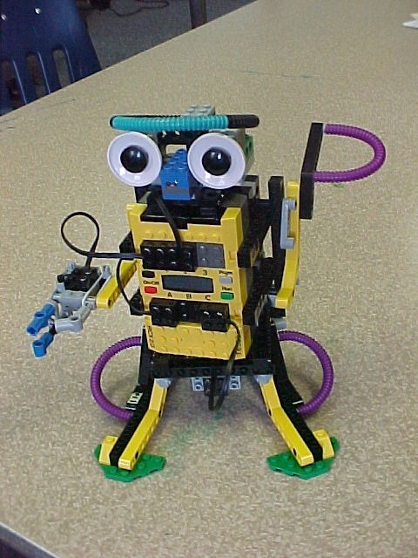
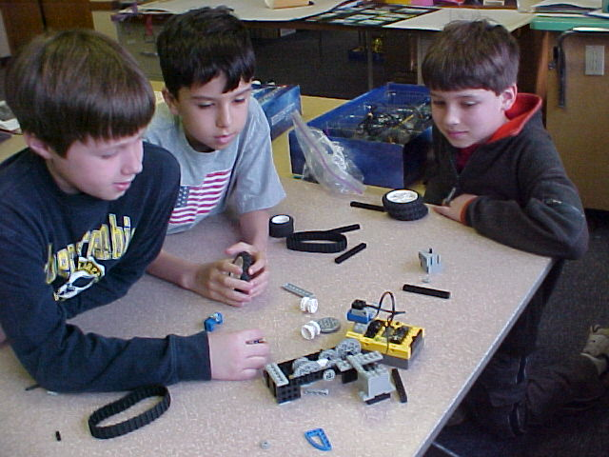
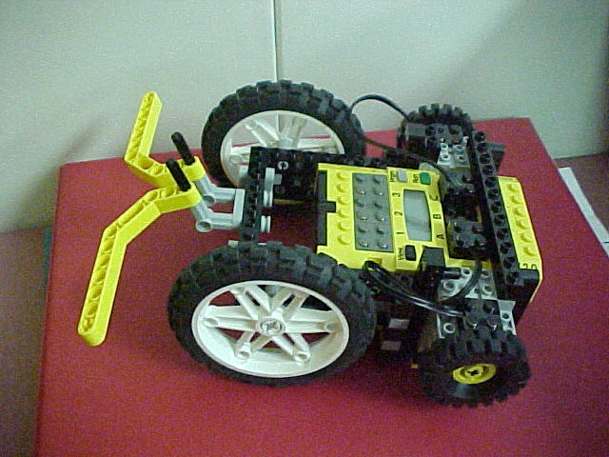
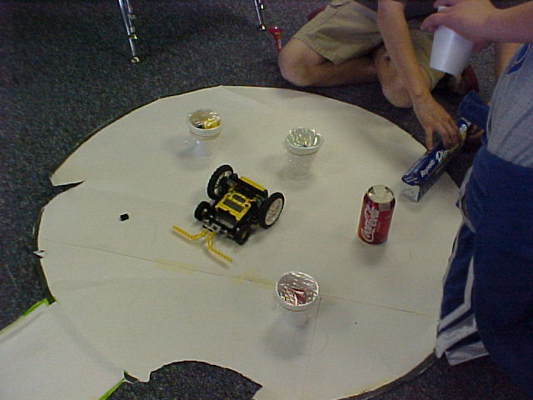
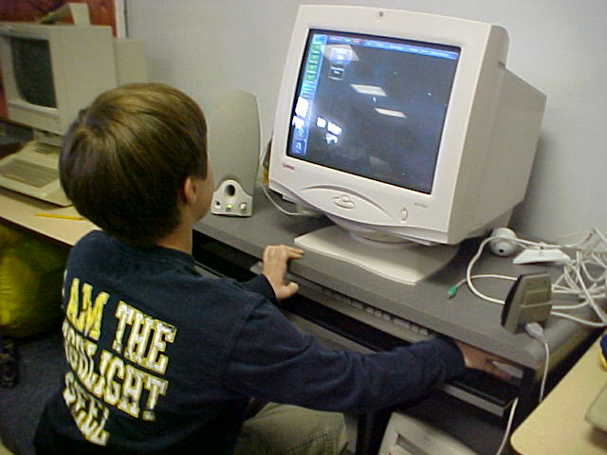
Robotics
Robolab
Mindstorms

Slide 76
Re-Thinking the Way We Do Things When Adding Technology. . .
Be willing to learn from students
Teachers still have much to offer: critical thinking, unlocking meaning, clear communication, etc.
Teaching with technology can be transforming
Encourage student autonomy
Dual level of teaching content along with meta-cognition- learning how to learn
Learning is cumulative – education is ongoing and doesn’t end with a test
Welcome productive digressions
A lot of work – build a collaborative team, and consider including students as part of the team

Slide 77
Where Do I Start?
What content, topic, or lesson should I start with?
What technology may help students to better understand?
Where can technology enhance the content, process or products in my classroom?
What technology can assist in meeting student readiness, interests, or learning styles?
Who will assist me?
School personnel, other teachers, technology experts
Who will support me?
Administrators, curriculum specialists . . .
What more do I need to get started?
Resources
Information
Access

Slide 78
Additional
Resources

Slide 79
Technology Integration help for teachers
Edutopia (GLEF)
Technology Integration for Teachers resources for reading and doing
Best on the Web
Kevin Honeycutt
Tammy’s Technology Tips
Tammy Worcester
Eduscapes
Annette Lamb and Larry Johnson
4Teachers
Education World – Technology in the Classroom

Slide 80
Assessment and Dealing with Parents
Communication
Helping parents understand a different way of learning
Explaining why all students are not doing the ‘same’ thing at the ‘same’ time.
Rubrics, Rubrics, Rubrics
Rubistar,

Slide 81
Summary
“With both DI and teaching with technology, your role as teacher is ever-changing as you adapt. What remains anchored are the essential questions and the processes of learning how to learn. With these in place, and with flexibility, inquisitiveness, and a pioneer spirit, you can keep things interesting for everyone.”
Amy Benjamin
Differentiated Instruction Using Technology

Slide 82
The Business of Schools
The Business of Schools Is to produce work that engages students, that is so compelling that students persist when they experience difficulties, and that is so challenging that students have a sense of accomplishment, of satisfaction—indeed, of delight—when they successfully accomplish the tasks assigned.
Inventing Better Schools * Schlechty

Slide 83
A Multitude of Resources
AT&T Knowledge Network Explorer
Teaching and Learning Center $
K-12 TLC Student Research Center.htm
Welcome to K-12 TLC Community Learning Center.htm
Mrs. Sheets Research Guide to Endangered Animals
TLC Guide to Endangered Animals.htm
Activity: Calendar/Daily activity for older elementary.htm
American Memory Science and Innovation Treasure Hunt.htm
Kindergarten activities Links.htm
Quia Web.htm $
Sites that help classroom teachers adjust their teaching process to their learners needs.htm

Slide 84
Online Resources For DI in Technology
Project GATE
Differentiation in detail
Differentiated Instruction Using Technology
EduScapes A Site for Life-long Learners
Internet 4 Clasrooms (sites to help classroom teachers adjust to DI
Technology & Learning - The Resource for Education Technology Leaders Teachers

Slide 85
More Resources . . .
Technology Resources for Differentiated Instruction Montgomery County.htm
Thinkfinity - Education & Technology in the 21st Century (MarcoPolo)
ThinkQuest
Using Technology to Differentiate Instruction.htm
Funbrain – Curriculum Guide
The Teacher Tap – professional development resources for educators (Annette Lamb and Larry Johnson)
Thirteen Ed Online
Rubrics for Assessment

Slide 86
National Organizations Curriculum on the Web
National Science Teachers Association
http://www.nsta.org
National Council of Teachers of Mathematics
http://www.nctm.org
National Council for Social Studies
http://www.ncss.org
Kennedy Center ArtsEdge
http://artsedge.kennedy-center.org
National Council of Teachers of English
http://www.ncte.org
International Reading Association
http://www.reading.org

Slide 87
Science
American Museum of Natural History
University of California Museum of Paleontology
Museum of the National Academy of Sciences
Human Genome Project
National Institute of Health
Education Resources
Science NetLinks
Hubble galaxies far, far away
HHMI Resource Center

Slide 88
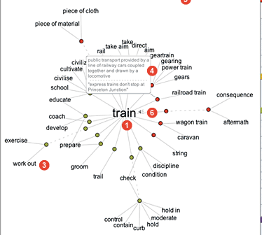
Mathematics
Mathematical Interactive Tools
The Math Forum @ Drexel University
A Creative Encounter of the Numerical Kind
Language Arts
Carol Hurst’s Children’s Literature
Site
The Complete Works of Shakespeare
Thinkmap Visual Thesaurus $$

Slide 89
History – Social Studies
Teaching US History
Primary Source Materials and Document Based Questions
Digital History
Veteran’s History Project
DoHistory
National Geographic Expeditions
Econ EdLink

Slide 90
Contests and Competitions
Christopher Columbus Awards
Cybermission
Toshiba

Slide 91
Interesting Ideas
Digital Library and Archives
What Kids Can Do
http://whatkidscando.org/

Slide 92
A Multitude of Resources
SAM animation (www.samanimation.com)
Scratch (scratch.mit.edu)(scratched.media.mit.edu)
Story starters/scholastic.com (teacher.scholastic.com/activities/storystarters/storystarter1.htm)
Timelines.com
In Plain English
Social bookmarking
You Tube (cartooning, music, history, more)
Evernote

Slide 93
Myths.e2bn.org/story_creator Mrssmke.onsugar.com/3307628 On Digital Storytelling
also handouts.wesfryer.com/digitalstorytelling and www.isteconnects.org/2009/06/07/digital-storytelling-my-top-10-lessons-learned/ and electronicportfolios.org/digistory/index.html
Technology enhanced book reports www.theapple.com/benefits/articles/8529-10-technology-enhanced-alternatives-to-book-reports
Online Physics Games www.physicsgames.net
Chemistry – chemeddl.org (chemical education digital library)
periodic table live chemeddl.org/collections.ptl/index.html
www.cogito.org webcasts videos – avian einsteins Johns Hopkins Center for Talented Youth
TED

Slide 94
Teachertube.com
Secondlife
Bighugelabs.com
Smithsonian panoramic virtual tour
www.mnh.si.edu/panoramas
Visual/Virtual Field Trips
Mrssmoke.onsugar.com/2959452
www.livemocha.com foreign language
Timeglider.com

Slide 95
Wolfram alpha www.solframalpha.com searchengine
Remembering Apollo 11 www.boston.com/bigpicture/2009/07/remembering_apollo_11.html
Virtual Pioneers (SL social studies ning)
www.schoonoodle.com K-12 social bookmarking community
NASA do it yourself Podcast www.nasa.gov/audience/foreducators/diypodcast.index.html
Sounds of Science podcast www.nap.edu/podcast.html

