Slide 1
Technology Tidbits for Teachers
Cindy Sheets

Slide 2

‘Our kids will spend the rest of their lives
in the future.
Are we getting them ready?’
Notes:
Are you a different learner than you were 5 or 10 years ago?
Not just a new way to do the same old thing (copy and paste to the new application)
Do things in ways we’ve never done them before.

Slide 3
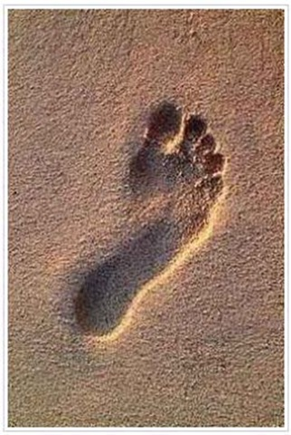
Digital Footprints

Slide 4
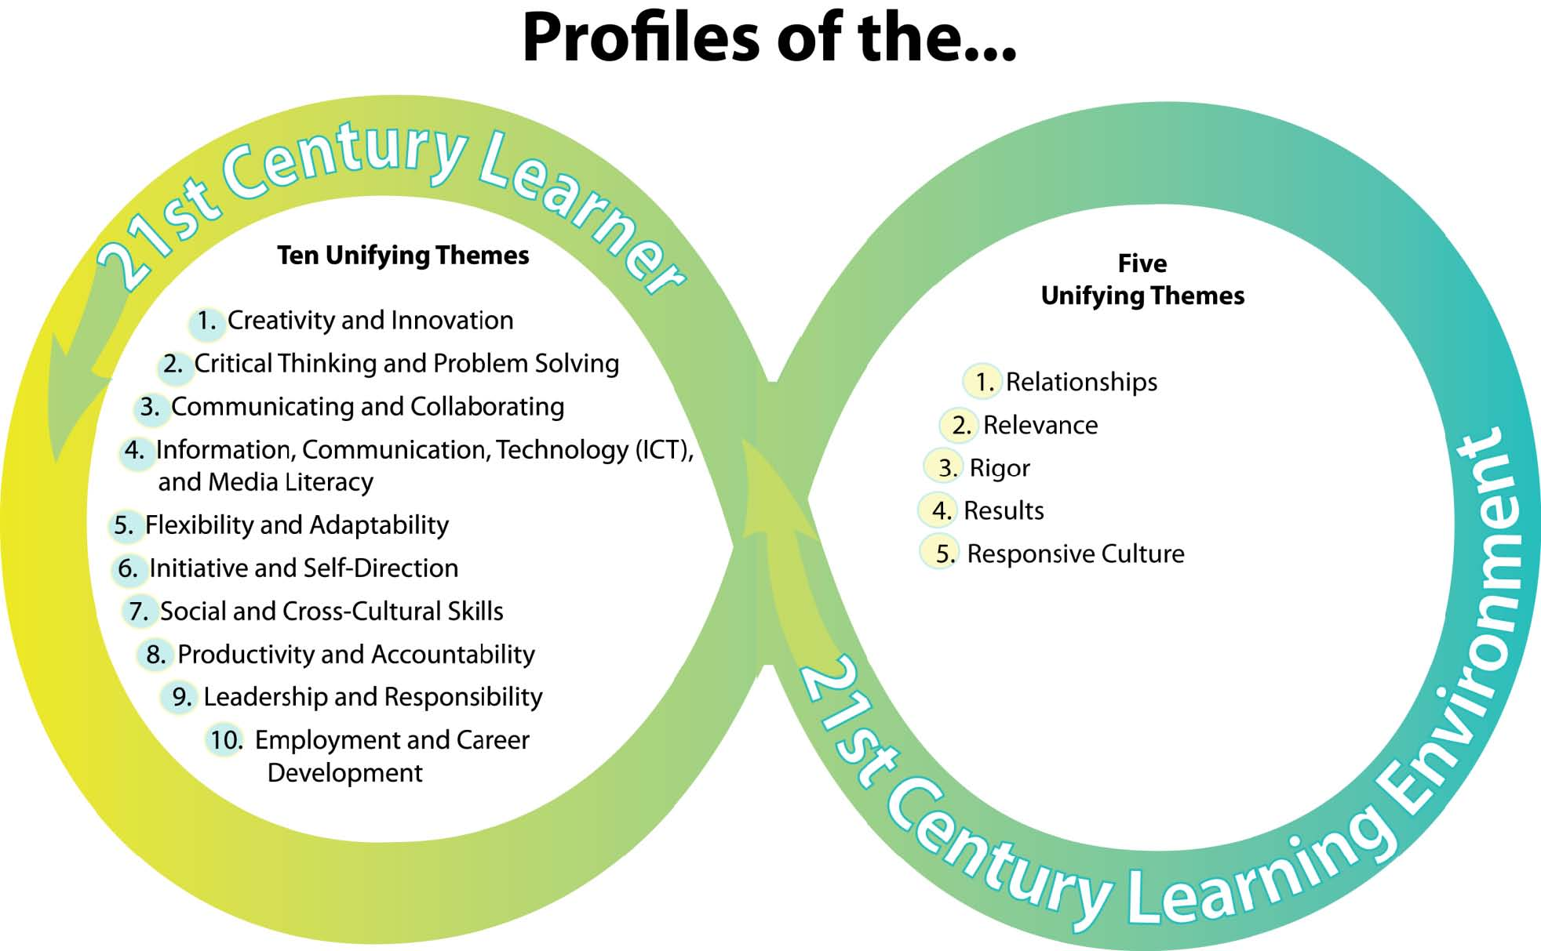

Slide 5
Join the Group!
www.Classroom20.com
  Community of teachers
  Live learning sessions
ALMnetwork.ning.com
  Online community supporting users of the Autonomous Learner Model
Plurk.com

Slide 6
Skype www.skype.com

Slide 7

Google Goodies
Alerts – topics or digital footprints
Earth
  Moon, Mars, Ocean too
Maps
Sketch-up
  Create models and include in Google Earth
Docs
Surveys
Books
Goog 411
More Google
Sites

Slide 8


Social Bookmarking
Social bookmarking is a method for Internet users to share, organize, search, and manage bookmarks of web resources. Unlike file sharing, the resources aren't shared; merely bookmarks that reference them.
Delicious Diigo
http://delicious.com/ http://www.diigo.com/
and Diigo in Education

Slide 9
Organize
Livebinders
  http://livebinders.com/shelf/my
Dropbox
  Storage online – cloud!
  http://www.dropbox.com
Linkable
  http://www.linkable.com/teacherricks

Slide 10
Web Site Creation
Google Sites
Weebly.com
Webs.com

Slide 11


Mind Mapping
Mind maps are used to generate, visualize, structure, and classify ideas, and as an aid in study, organization, problem solving, decision making, and writing.
Wordle
http://www.wordle.net
/
Bubbl.us
http://bubbl.us/
Tagxedo
www.tagxedo.com Tag Cloud with Style

Slide 12
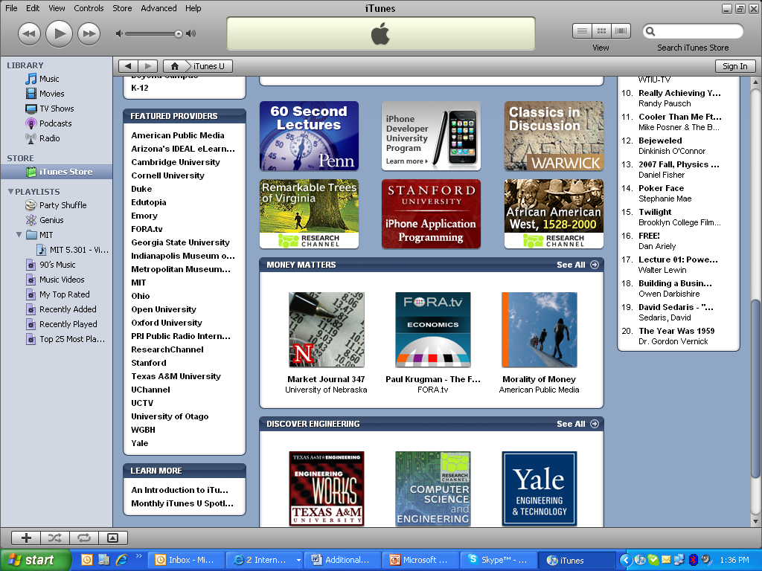
iTunes U

Slide 13

iTunes U

Slide 14

Conversion Tools
Media-Convert
Zamzar

Slide 15

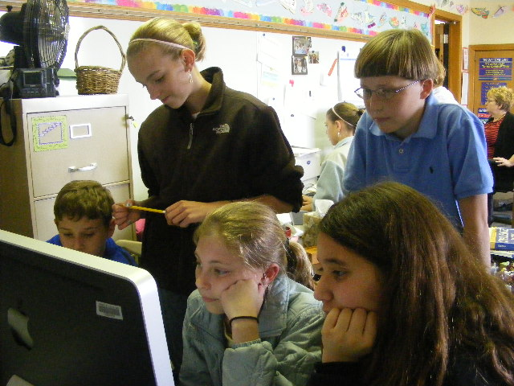
Podcasts
iTunes
Ted Talks

Slide 16
Learn & Create with Podcasts
Collect
Create
Science Now (NOVA) podcasts
http://www.pbs.org/wgbh/nova/sciencenow/rss/#h01
iTunes
Podbean.com
Ted Talks
  http://ted.com
Learning in Hand
  learninginhand.com
Gcast
  http://gcast.com
Garageband (Apple)
Audacity
  Sourceforge.audacity.net

Slide 17
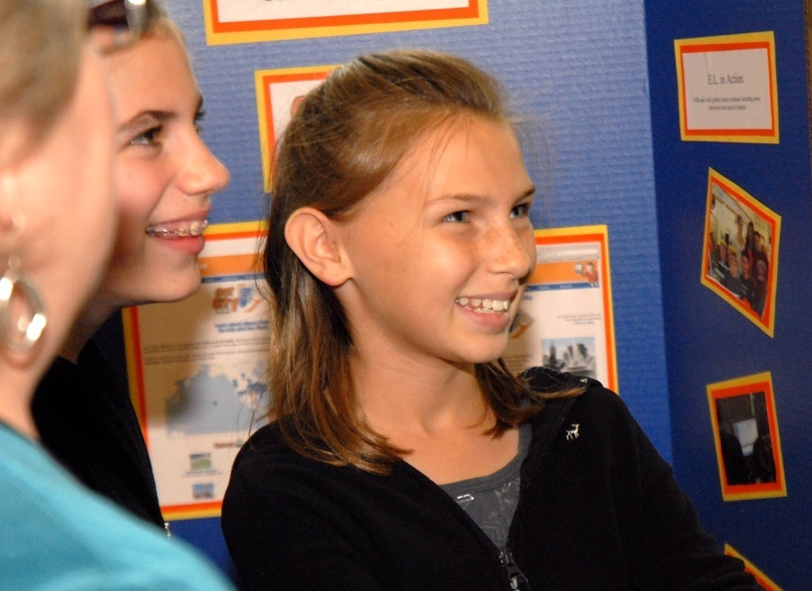
Photos
Creative Commons
Flickr
Big Huge Labs
  National Park Trading Cards
FlickrCC
Gimp
Photoshop Express
Image Mosaic Generator
Picasa

Slide 18
Free Programs
Scratch
Alice
Pivot Stickfigure Animator
  www.snapfiles.com/get/stickfigure.html
Sam Animation

Slide 19
More Google Goodies
Trends
Scholar
Image Swirl
Similar Image
Audio Indexing
City Tours
In Quotes

Slide 20


Communication & Social Networks
Ning communities
  Classroom 20
Wikis
  http://www.wikispaces.com/user/my/hisheets
Skype
Plurk
Edmodo
Voice Thread ($ options for private groups)
Google Calendars
Twitter

Slide 21
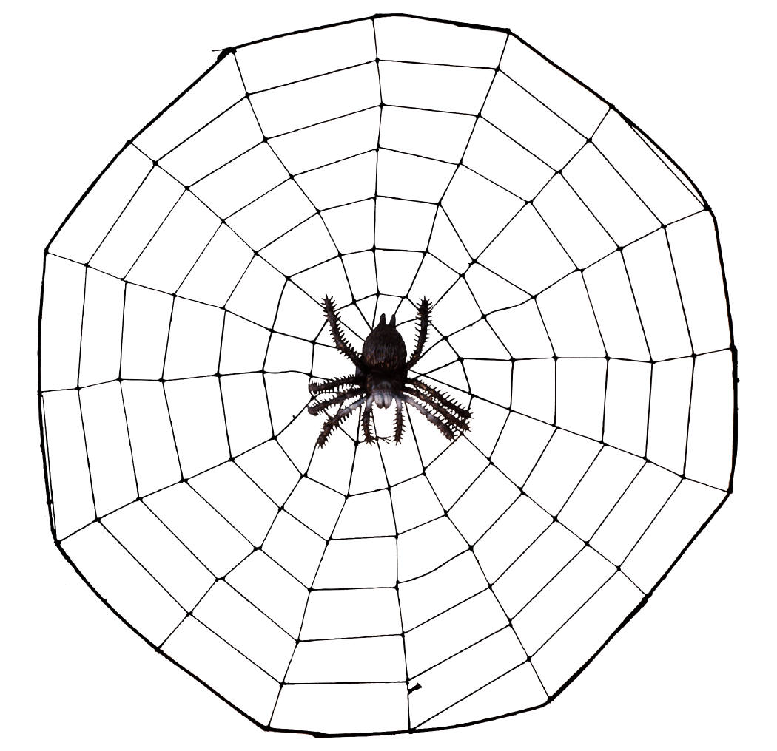
101 Teaching Tools for Web 2.0
http://oedb.org/library/features/101-web-20-teaching-tools
www.kevinhoneycutt.com
Technology Bits, Bytes &
Nibbles
  Cyndi Danner-Kuhn

