Slide 1
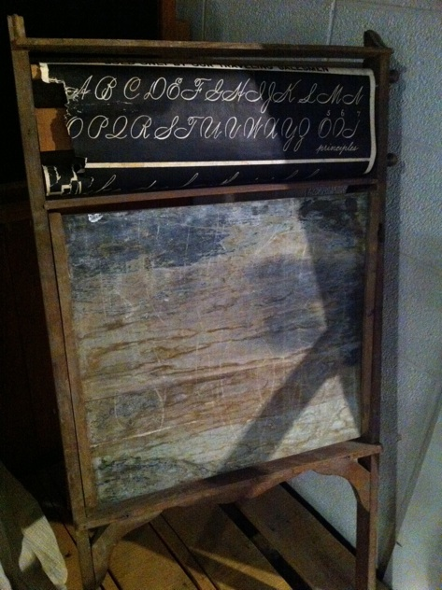
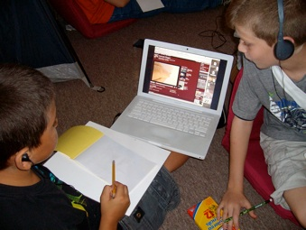
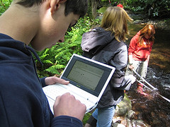
“
Tech Tool Time: Jazzing up Lessons for 21st Century Learners
Cindy Sheets
cindysheets@aha-learners.org
NAGC
2011

Slide 2
You can find my presentation here:
cindysheets.weebly.com

Slide 3
In a time of drastic change, it is the learners who inherit the future.
The learned find themselves equipped to live in a world that no longer exists.
Eric Hoffer

Slide 4
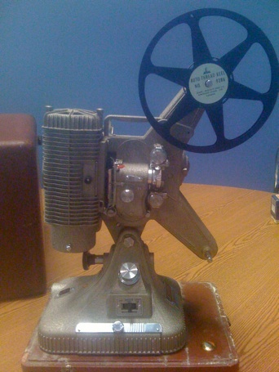

Slide 5
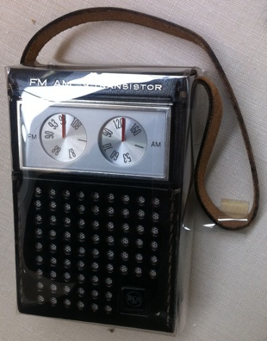
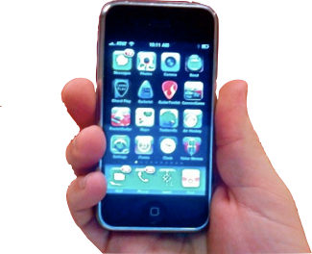

Slide 6
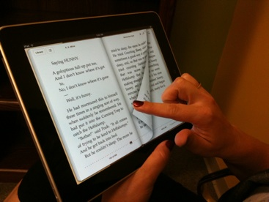
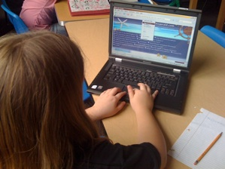

Slide 8
It’s not about the tools,
it’s about using the tools to
facilitate learning.
Andrew Churches

Slide 9
A tool is an instrument used to help you do work. It can be anything that helps you accomplish a goal.
Consider how technology tools can help your students do meaningful work.

Slide 10
How will technology tools
help your students learn
and share their understandings?

Slide 11
Chris Lehman - http://practicaltheory.org/serendipity/ ISTE 2011 ending keynote
Goals of School:
Inquiry – ask questions
Research – answer questions
Collaboration – deeper, richer learning
Presentation – share what you’ve learned
Reflection – what did I learn? How did I do? Mistakes are OK as long as I’m learning
Working toward independent and self-directed learners.

Slide 12
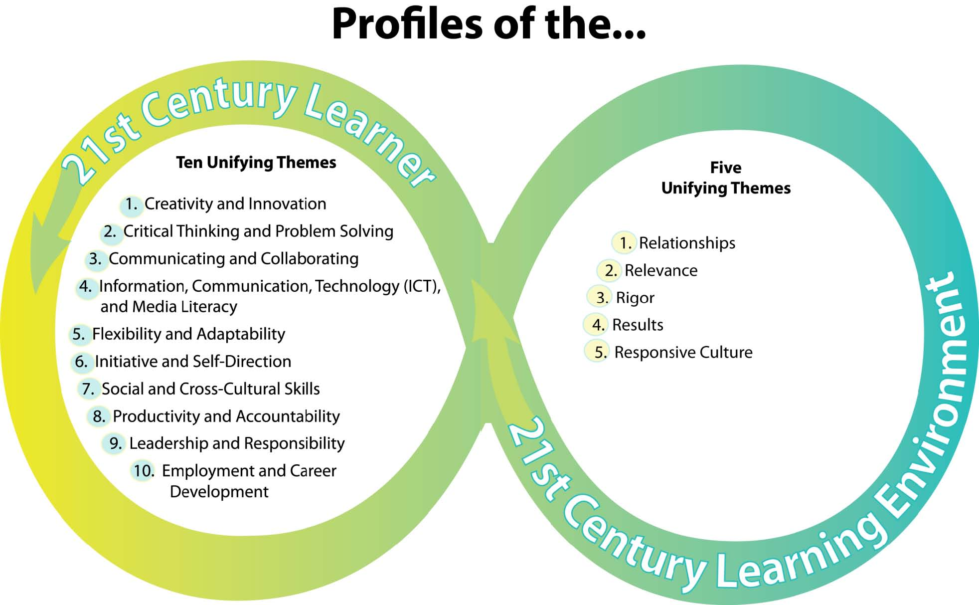
http://www.ksde.org/Portals/25/Profile%20Bullets%2011-3-2008%20markup%20v5.pdf

Slide 13
Digital Bloom’s Taxonomy
Digital Bloom’s – find much more online . . .
http://Livebinders.com/play/play_or_edit?id=54645
http://farr-integratingit.net/Theory/CriticalThinking/index.htm
http://edorigami.wikispaces.com/Bloom's+Digital+Taxonomy
http://edorigami.wikispaces.com/file/view/bloom's+Digital+taxonomy+v3.01.pdf
http://visualblooms.wikispaces.com/

Slide 14
http://visualblooms.wikispaces.com/

Slide 15
Examples of Tooling Up
Creating the 21st Century Learning Environment

Slide 16
Paleontology Lesson
Show a YouTube video about Mary Anning and of Lyme Regis where Mary lived and worked. (4)
Collaborate with team members to solve problems (3)
Use Internet Search tools to locate diagrams/pictures of anatomy (2)
Hear the latest research directly from a famous paleontologist (60 Minutes) (3)
Skype with a paleontologist or museum worker (10)
Virtual dig (2)
Student blog about their discoveries instead of a written journal entry (4)

Slide 17
Research Information
Email an expert in the field
Skype with an expert
Utilize search engines and specialty searches
Survey and collect data – using Survey Monkey or Google Docs Forms
Conduct an interview using an iPod, iTouch or FlipCam
Working with a team? Try Google Docs or create a Wiki
Organize with LiveBinder or another tool.
iTunes U
Ted Talks

Slide 18
Research Study – Share Results:
Write a report or other written document
Or create an animated Slide Show
Or create a video or audio documentary
Or create a PowerPoint or Keynote or Prezi
Or create a podcast
Or write and self publish a booklet or other written work
Share your findings in a Wiki or Create a Web Page
Digital Storytelling

Slide 19
Tools
Develop an Animated slide show: Animoto, Prezi
Collaborate with a team to create a Video or audio documentary: iMovie, Garageband, Audacity, FlipCam
Create a Podcast: Audacity, Aviary Myna, Garageband
Self Publish written works: Lulu
Wikispaces Work with a team to share and develop content
Skype and Oovoo work with others across cultural boundaries
Create and produce websites: Weebly, Wix, Webs

Slide 20
Writing
Publish your own work: Lulu
Blog: http://kidblog.org/home.php
Create an online Poster at Glogster http://edu.glogster.com/
Create an ebook or emagazine http://simplebooklet.com/index.php# http://www.scribd.com/

Slide 21
Google Tools
Google Earth: geography, lit trips, history of famous places
Google Docs: shared work space
Google Spreadsheets
Google Forms (surveys)
Slide shows
Calendars
And much more . . .

Slide 22
Kids today have much less fear around technology—and they can pick up the basics right away. But they still don’t know how to learn with these technologies, or how to connect with others from a learning standpoint as opposed to a social standpoint.
Will Richardson

Slide 23
Learn Together
As a teacher, you frame and plan the learning experiences.
This doesn’t mean that you have to know how to do every step in the technology process. Start the process and learn together. Allow students to take the lead in using technology.
Collaborate with your students – enjoy the adventure!

Slide 24
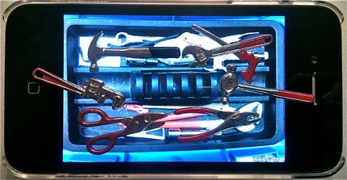
Let’s “Tool Up” your lessons
and see where
TODAY’S TECHNOLOGY TOOLS fit in.

Slide 25
Langwitches (Sylvia Rosenthal Tolisano)
http://langwitches.org/blog/2011/01/22/unpack-upgrade-and-bring-your-lesson-into-the-21st-century/

Slide 27
Now It’s Your Turn
How can you “Tool Up” a lesson you’re planning to teach in the coming months?

