Slide 1
Podcasting
The World IS Your Stage
Cindy Sheets NAGC 2010
cindysheets@smsd.org

Slide 2
Tools of the Trade
Myna

Slide 3
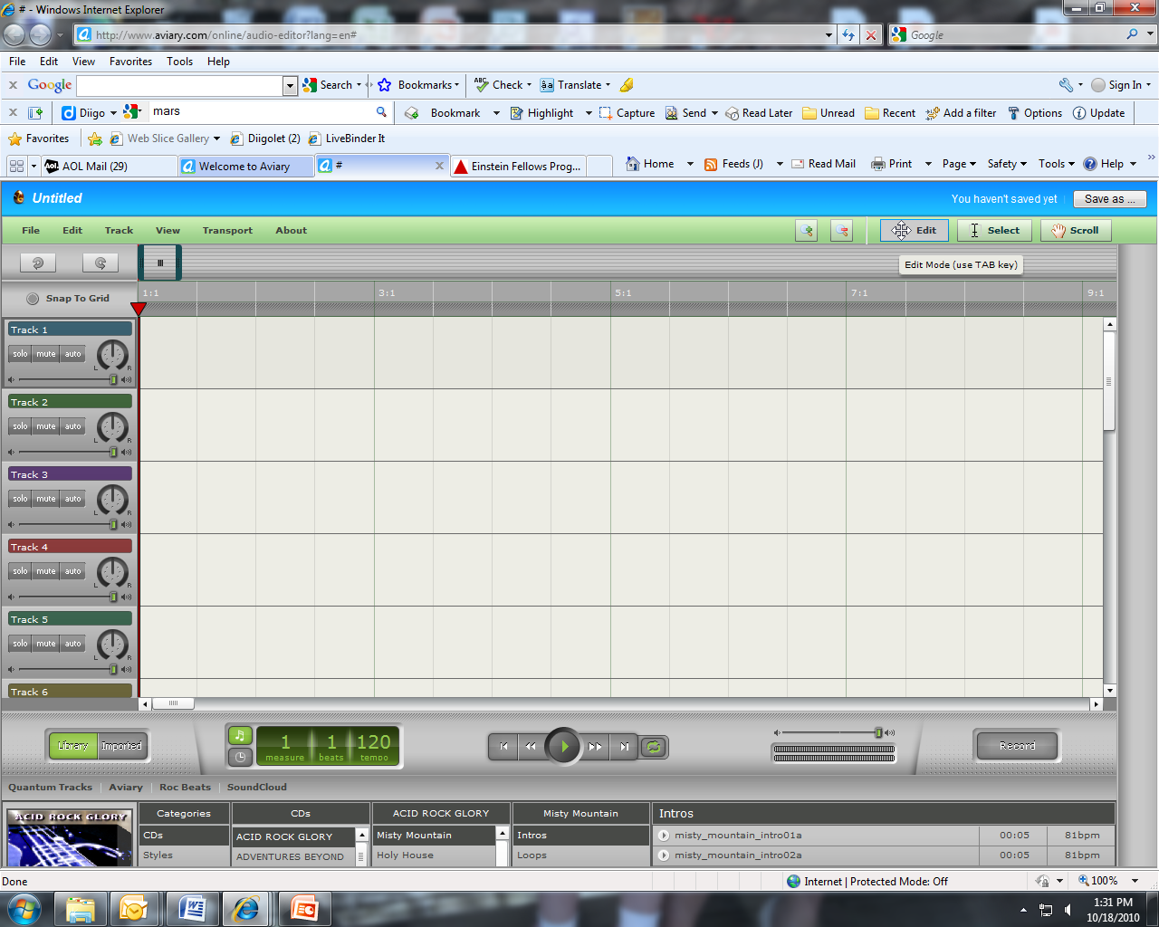

Slide 5
Audacity
http://sourceforge.audacity.net

Slide 7
What Makes It Great?
Great Content
Good Script
“Stage Presence”
Variety
Creative
Music, Jingles

Slide 8
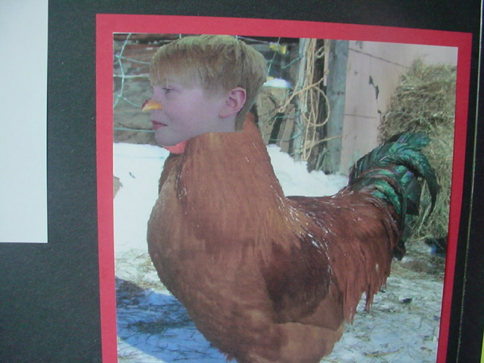
EL in Action
Problem Based Learning

Slide 9
Learning in Hand
http://learninginhand.com/OurCity

Slide 10
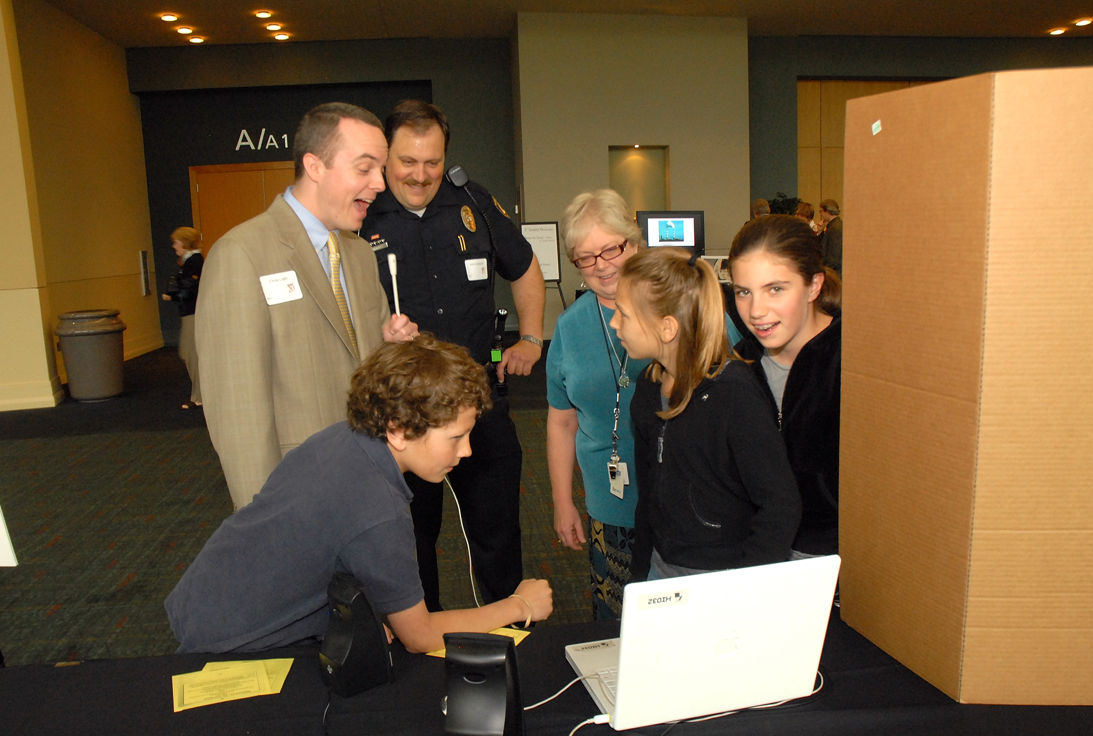

Slide 11
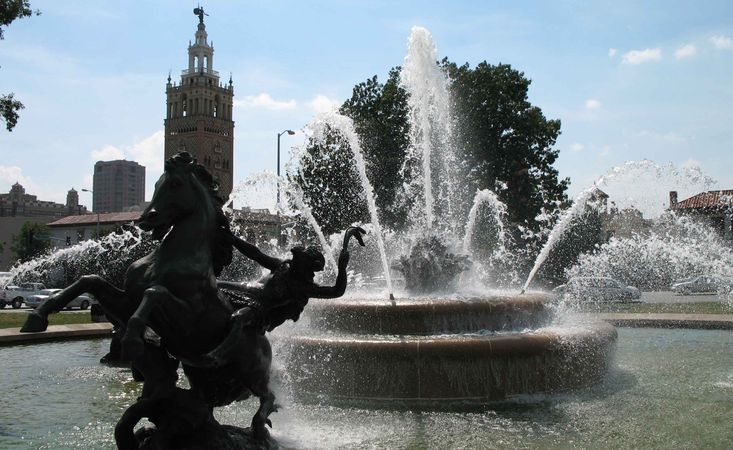
The World as an Audience
RADIJOJO-founder Thomas Röhlinger
Founded in 2003, located in Berlin, Germany
http://www.across-the-ocean.org/
Creative Commons license
Public Domain

Slide 12
Content?
Storytelling
Science
Social Studies
Final Sharing – Reports and Research
Home/School communication
What we learned today . . .
Examples:
EMS
The Body Speaks
Currently
Halo Awards
Sportscast of the First Olympics

Slide 14
Online Tutorials
Garage Band
http://www.apple.com/ilife/tutorials/garageband/tutoriallist.html
Audacity
http://www.how-to-podcast-tutorial.com/17-audacity-tutorial.htm
http://wiki.audacityteam.org/wiki/Audacity_Wiki_Home_Page
http://www.guidesandtutorials.com/audacity-tutorial.html
Aviary Myna
http://www.youtube.com/watch?v=_3-VWMKpQiI&feature=player_embedded#!

Slide 15
Resources
http://audacity.soundforge.net
http://aviary.com
http://aviary.com/online/audio-editor?lang=en#
http://learninginhand.com
Podcasting booklet “how to” by Tony Vincent

