Slide 1
Gifted Education: Preparing for the Future
Cindy Sheets
Shawnee Mission School District
December 7, 2011

Slide 2
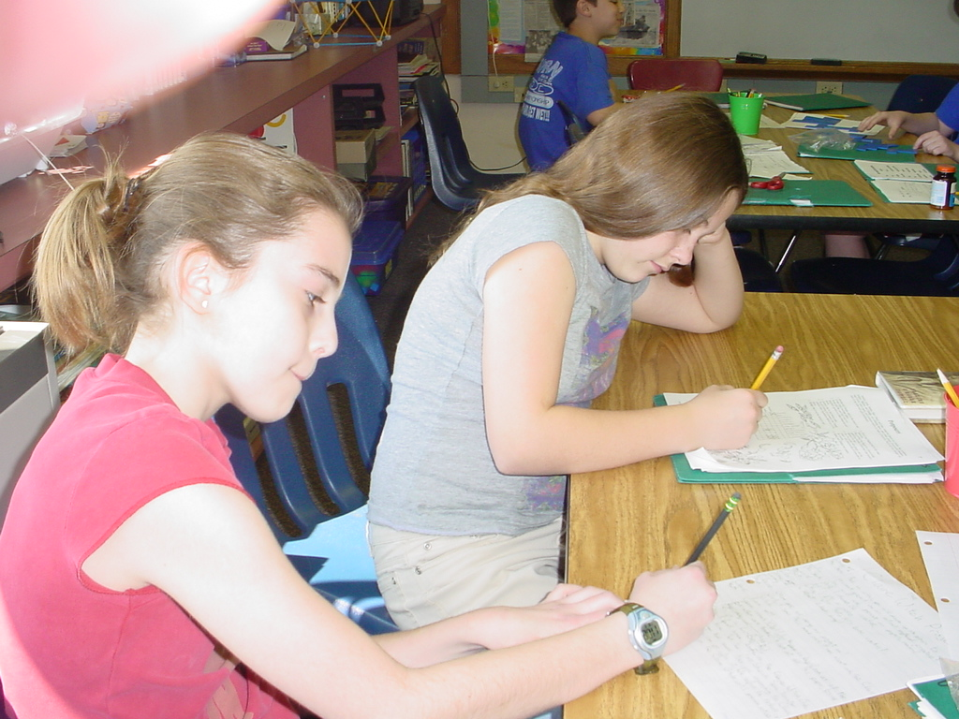
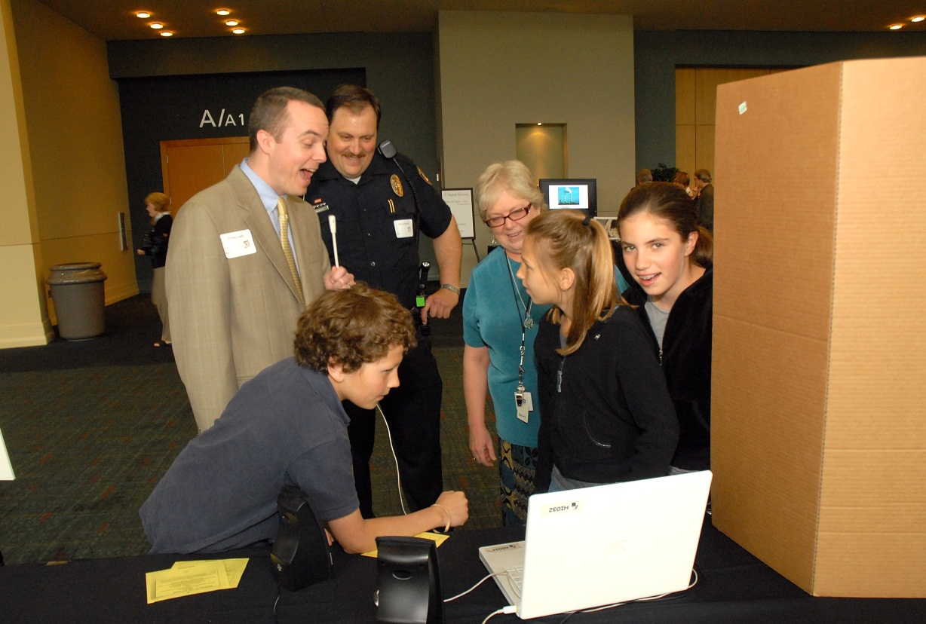
What is Same/Different for our Gifted Students in Today’s Classroom?

Slide 3
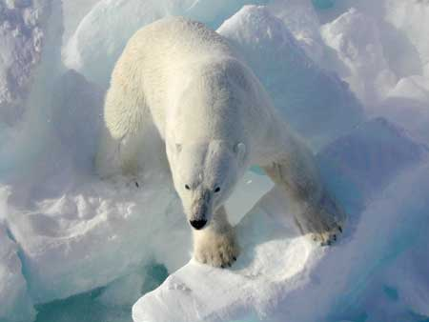
The Landscape is Changing
USGS Public Domain
http://en.wikipedia.org/wiki/File:Polar_bear_arctic.JPG CC

Slide 4
New Definitions of Giftedness
Fixed vs Malleable
Talent Development
Gifted education has contributed greatly to general education “best practices”
Problem-based learning, differentiation, cluster grouping, creative/critical thinking, Bloom’s Taxonomy
Research – Talent Development based
Giftedness as a state one grows into and acquired as a result of learning and achievement
Practice – G as a stable trait identified through testing
Programs driven by identification rather than by service models

Slide 5
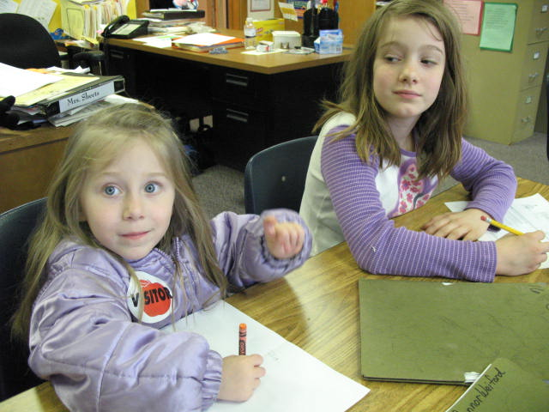
Malleable Minds
Psychologists now believe that IQ represents only a part of intelligence, and intelligence is only one factor in both retardation and giftedness. . . . The growth of a more recent concept, the malleability of intelligence, has also served to discredit labeling.
http://www.cpsimoes.net/artigos/art_brit_1.html

Slide 6
IQ May Not Be Stable
As Brain Changes, So Can IQ
Wall Street Journal, 10-20-2011
Changes up to 20 IQ points (both directions)
Study reported in Nature
http://online.wsj.com/article/SB10001424052970203752604576641133332697322.html

Slide 7
Mindset
Research work of Dr. Carol S. Dweck
Fixed or Growth Mindset
Internal beliefs about your own intelligence
Praise
Negative or positive
Importance of effort and belief that brain is malleable

Slide 8
Paula Olszewski-Kubilius
From the NAGC President
Taking a Bold Step
http://newsmanager.commpartners.com/nagc/issues/2011-11-15.html

Slide 9
Parents and teachers who take to heart the message that ability is malleable and teach their children accordingly lay the long‐term groundwork for eager, courageous learning and the willingness to stick with the difficult.
Nancy M Robinson, University of Washington, Seattle

Slide 10
What Does This Mean for Gifted Education?

Slide 11
Changing Roles of Gifted Education Specialist

Slide 12
A more elaborate, expansive, and integrative gifted education program illustrates the new roles and responsibilities of gifted education specialists. These include providing instructional support for classroom teachers, direct educational services, coordination of out-of-school resources and programs, and advice on curriculum and instruction.
~Nancy Hertzog

Slide 13
A more elaborate, expansive, and integrative gifted education program illustrates the new roles and responsibilities of gifted education specialists. These include providing instructional support for classroom teachers, direct educational services, coordination of out-of-school resources and programs,
and advice on curriculum and instruction.
~Nancy Hertzog

Slide 14
The Other 80%
. . . research has found that differentiation of instruction for gifted students does not typically occur within the general classroom, collaboration between gifted and general
education teachers is critical in order to ensure appropriate services to students with high abilities.
Lessons From Another Field: Applying Co-teaching Strategies to Gifted Education
Claire E. Hughes Florida Gulf Coast University
Wendy A. Murawski California State University, Northridge
Gifted Child Quarterly Summer 2001

Slide 15
Advanced Students in Today’s Classrooms
32% - teachers say advanced students are low priority in their schools
73% of teachers agree – brightest are under-challenged
77% - needs of advanced take a back seat
10% - advanced students taught with specially designed curriculum and instruction
40% - HS – classes too often watered down and lacking rigor
65% little or no training in pre-service for GT
58% no professional development
Lack of accountability and monitoring
High-Achieving students in the era of NCLB, Fordham Institute
NAGC http://www.nagc.org

Slide 16
State of the States in Gifted Education 2011 * Only six states require pre-service training for regular classroom teachers on characteristics and needs of gifted students. Yet it is in the regular classroom where gifted learners are expected to have the bulk of their learning needs met. * In thirty-six states, regular classroom teachers are never required to receive training about the gifted learners who are inevitably in their classrooms.

Slide 17
What Does This Mean for Gifted Education?

Slide 18
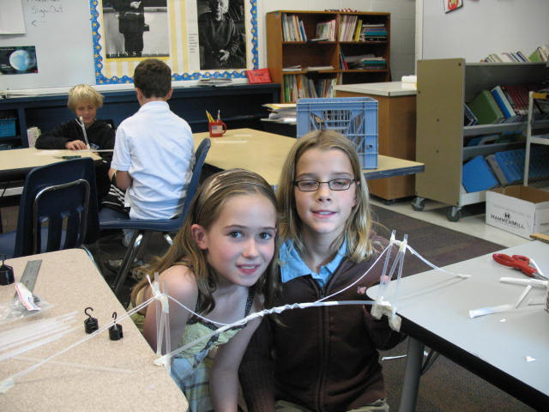
What’s Are We Doing Well for Gifted Students?

Slide 19
STEM and Gifted
President’s council
Report
http://www.nagc.org/index.aspx?id=1484

Slide 20
Prepare & Inspire
K-12 Education in STEM for America’s Future
PCAST
President’s Council of Advisors on Science and Technology
Bill Nye
Abstract thinking at early ages

Slide 21
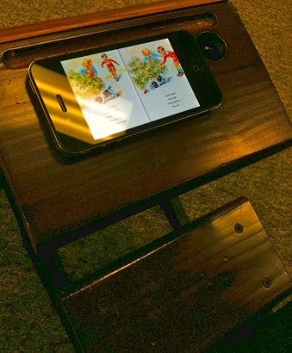
Using the Same Methods with New Tools
Insanity: doing the same thing over and over again and expecting different results.
Albert Einstein
Pictures courtesy of Kevin Honeycutt
http://unmaskdigitaltruth.pbworks.com/w/page/7254090/ediscovery

Slide 22
New Tools for New Learning

Slide 23
STEAM
At its very core, the STEAM movement is about integrated learning and most effectively preparing students for the 21st century challenges . . . If we ignore teaching students how to critically and creatively think, innovate and communicate using the tools provided to them, we do not fully prepare them for the future.
Amy Puffenberger is a recent graduate of the Master of Arts Management program at Carnegie Mellon University

Slide 24
21st Century Learning

Slide 25
21st Century Learning Environments Kansas
Relationships
Responsibility, transitions, partnerships
Relevance
Connected curriculum, student decision making
Rigourous Learning Environment
Core, 21st century themes, accelerated, collective responsibility for student success
Results
Every educator continues growth and expertise
Responsive Culture
Embrace innovation and creativity, students’ interests, motivating and challenging

Slide 26
Charting a New Direction

Slide 27
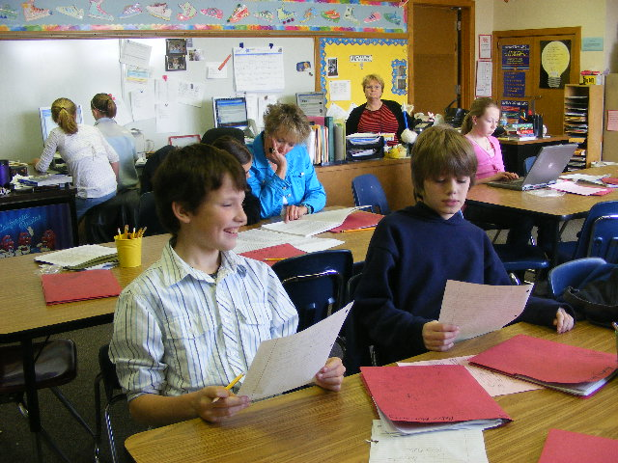
What Next?

Slide 28
Creative Producers
What are your students creating? Producing? Contributing?
Surveys
Books
Movies
Podcasts
Art
Digital Storytelling

Slide 29
Tools for Creation
Lulu.com
Sketch Up (Google)
Google Forms
iMovie
Garageband
Other?

Slide 31
Kevin Honeycutt.html

Slide 32
I Need My Teachers to Learn

Slide 33
Digital Citizenship
Protect?
Or Teach?

Slide 34
Digital Literacy

Slide 35
Northwestern
Concerns about students’ ability to:
Identify appropriate, reputable material online
Avoid plagiarism
Identify bias in information
Utilize queries effectively

Slide 36
Response to Intervention RTI

Slide 37
Core Principles of RtI

Slide 38
Thinking Points
What is happening (or not happening) in your own district/school?
Are high ability students being included in RTI?
Do you feel that they should be included?
Do teachers have the necessary support to include high ability students?
Training
Materials
Administrative support
Could RTI initiatives benefit in the identification process for gifted services?
Is your gifted specialist on the building/district RTI team?
Notes:
Turn to a neighbor and discuss these questions.

Slide 39
few
Intensive Support
some
Extra Support
All
Core Curriculum
some
Extra Support
few
Intensive Support

Slide 46
What Do Teachers Need?
Information about the characteristics, needs and best practices for high ability/gifted students
Training in strategies that are successful with high ability learners and how to create curriculum options that work.
Resources and supplemental materials that do more than repeat already learned skills (HOTS not MOTS)
Support from the school team

Slide 47
RTI: A Good Fit For High Ability Learners?
Yes
Response to student need
Universal screening
Quality curriculum
Differentiation in general classroom instruction
No
The need for interventions may NOT diminish
Interventions require more than discreet skills
Assessment & monitoring methods differ
Reduced need for core curriculum
Need to be with academic peers

Slide 48
Core or Level I tier.
For our struggling learners, Level I is where we find out what they can't do - and then provide the intervention to help them learn it.
For our gifted learners, it's where we find out what they ALREADY know/can do - and then provide the intervention to help them move beyond that.

Slide 49
Curriculum Experts?
Who, me?
Differentiation is NOT easy
How can we help classroom teachers enrich and challenge our gifted students?
Advocate for their right to learn something new every day

Slide 50
Common Core Standards
Increasingly important to advocate for advanced students
Expanded role as mentor/coach in implementation efforts and understanding needs for differentiation
http://www.nagc.org/index.aspx?id=8982

Slide 51
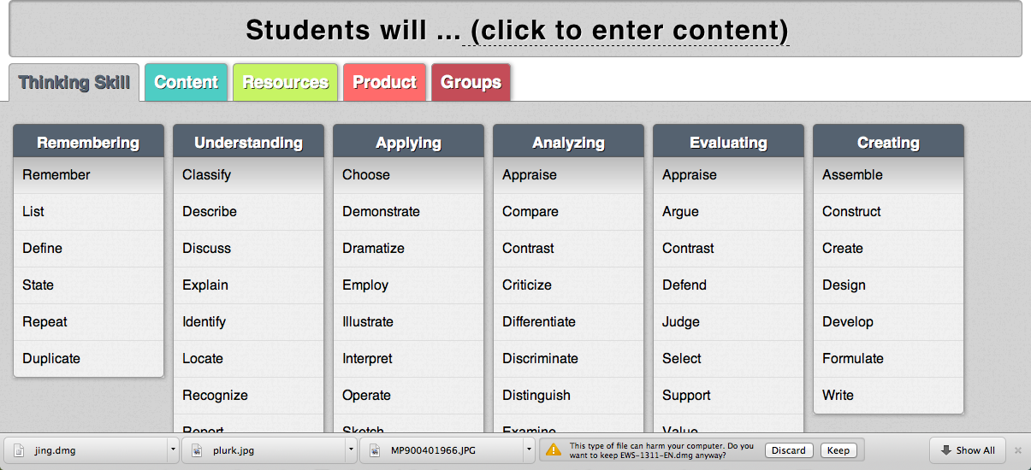
ByrdSeed
/Users/cindys2449/Documents/Byrdseed Differentiator.pn
Improve your gifted classroom booklet
http://www.byrdseed.com/714p898d4591f/Improve%20Your%20Gifted%20Classroom.pdf

Slide 52
COLLABORATION
NAGC believes in the importance of collaboration among gifted, general and special education programs, and the subsequent need to provide support for these efforts. Collaboration does not do away with the need for services associated with gifted education programming, but rather redefines the roles of educators in the overall plan for gifted education.
Part of a continuum of services provided to meet needs
Cooperative planning time among general and gifted program staffs

Slide 53
Collaboration PLN
http://nagc.org/index.aspx?id=546
PLN – http://plurk.com

Slide 54
Need Reinforcements?
Karen Rogers – synthesis of research on benefits of various service models
http://austega.com/gifted/articles/Rogers_researchsynthesis.htm
Lessons Learned about Educating the Gifted and Talented - Gifted Child Quarterly, 2007 (SAGE Publishing
Sandra Kaplan – concentric circles of knowledge – curriculum
Cluster grouping research
http://www.gifted.uconn.edu/nrcgt/gentry.html
Parallel curriculum – concept-based curriculum
NAGC bookstore
H. Lynn Erickson
Problem Based Learning, one to one laptops
Ginger Lewman ginglerl@essdack.org

